Slide 1
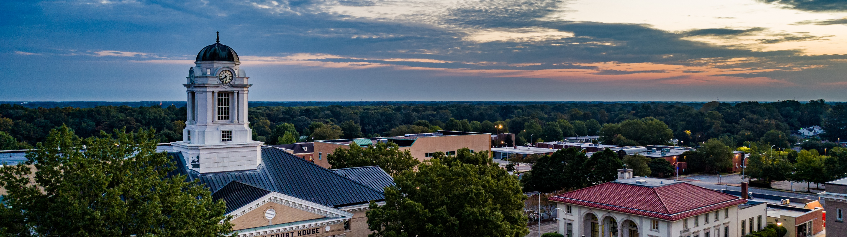

Pitt County Environmental Scan
October 7 - 9, 2025

Slide 2



What Is a Strategic Plan?
STRATEGIC PLAN
WHAT the County will prioritize and focus on
A LIVING DOCUMENT that guides decision- making
A TOOL for government transparency and accountability
HOW the County carries out its strategy to reach the vision,
priorities, and goals is defined in the Implementation Plan

Slide 3
Plan Development
  Review mission, vision, and core values.
  Review and refine strategic focus areas and goals for the next five years.
  Adopt the Strategic Plan.
Board of Commissioners
Pitt County Residents
County Staff
  Refine the Board’s work and create objectives and performance measures.
  Develop an implementation plan.
  Give information for the County Board and staff to consider in the development of the Strategic Plan.
  Provide feedback on the draft Strategic Plan.

Slide 4
How do Strategic Plan elements fit together?
VISION STATEMENT
MISSION STATEMENT
1
2
3
4
Strategic Focus
Area
Strategic Focus
Area
Strategic Focus
Area
Strategic Focus
Area
Goal Statement
Goal Statement
Goal Statement
Goal Statement
Objectives
Objectives
Objectives
Objectives
1
2
3
1
2
3
1
2
3
1
2
3
Measures
Measures
Measures
Measures
1
2
3
1
2
3
1
2
3
1
2
3
CORE VALUES

Slide 5

What Sources Inform the Strategic Plan?
Interviews with staff, community members, and the Board of Commissioners
Social Pinpoint Community Engagement Platform
Demographic and economic data
Currently existing County plans, and budget
Employee insights from survey
Community forums like this are a critical piece of the puzzle. They help gather input on where residents would like the County to focus resources.

Slide 6
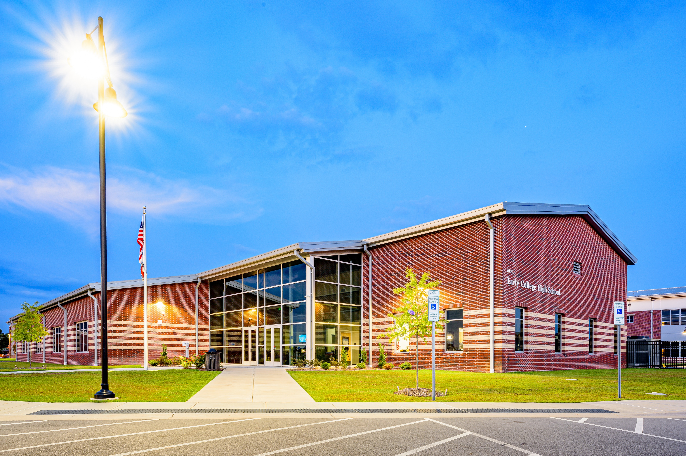

Community Profile

Slide 7




Population Data
$54,915
Median Household Income
90.2%
High School Graduate or Higher
$165,400
Median Home Value
20.4%
Residents in Poverty
Source: Pitt County, North Carolina Official Website, North Carolina Office of State Budget and Management,
American Community Survey (ACS) 5-Year Estimates for 2019–2023

Slide 8
Demographics: Race and Ethnicity
Source: American Community Survey (ACS) 5-Year Estimates for 2010–2022

Slide 9
Demographics: Age
Source: American Community Survey (ACS) 5-Year Estimates for 2010–2022

Slide 10
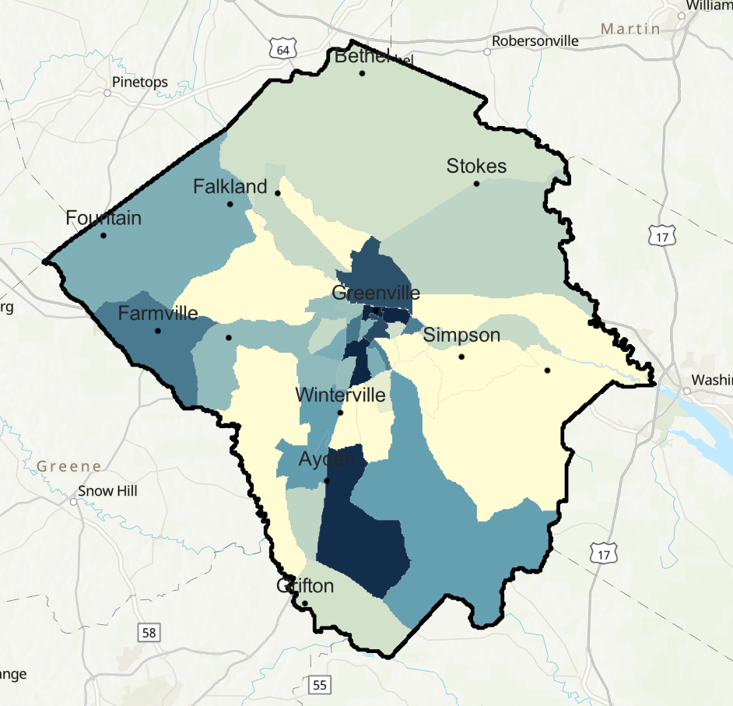
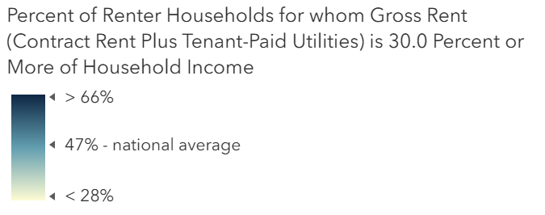
Housing Data
Source: Pitt County, North Carolina Official Website,
American Community Survey (ACS) 5-Year Estimates for 2019–2023

Slide 11
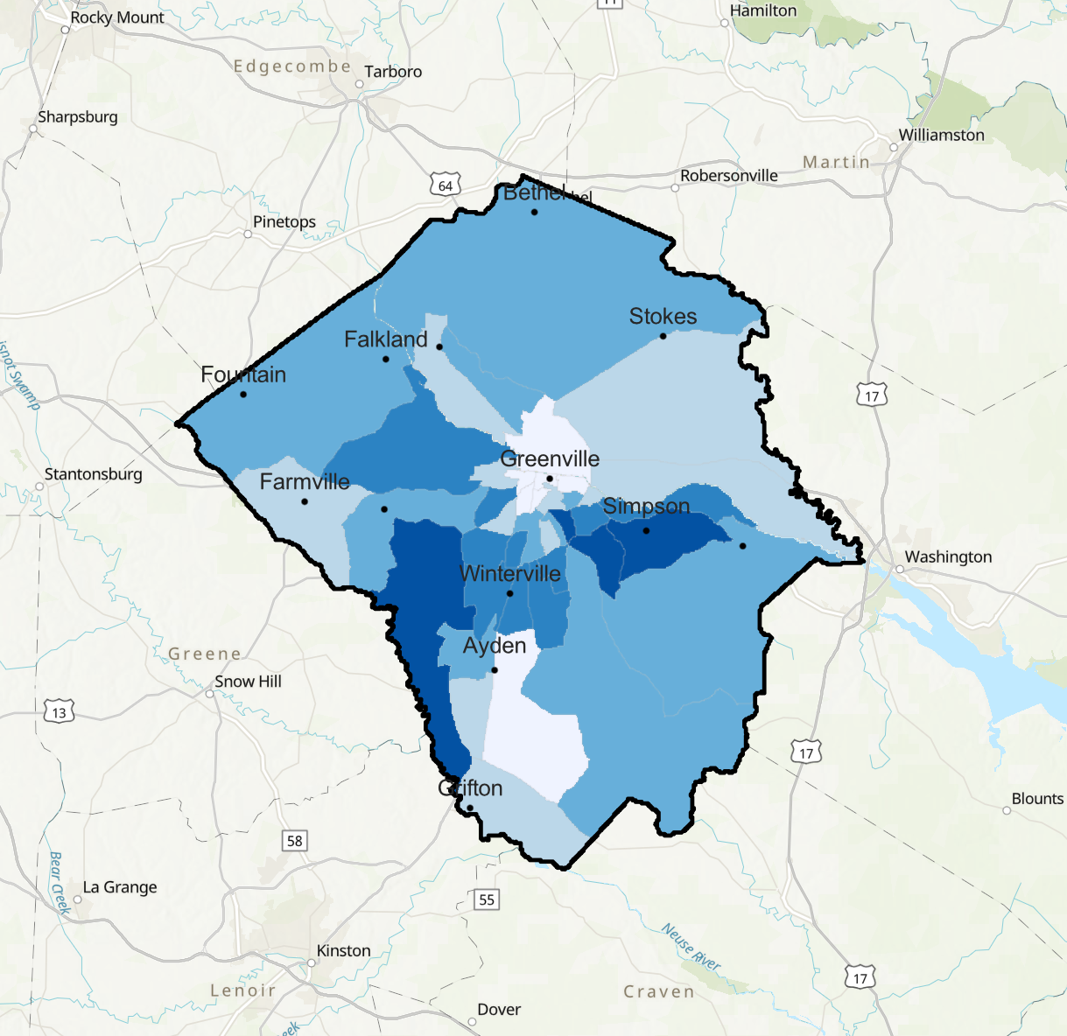
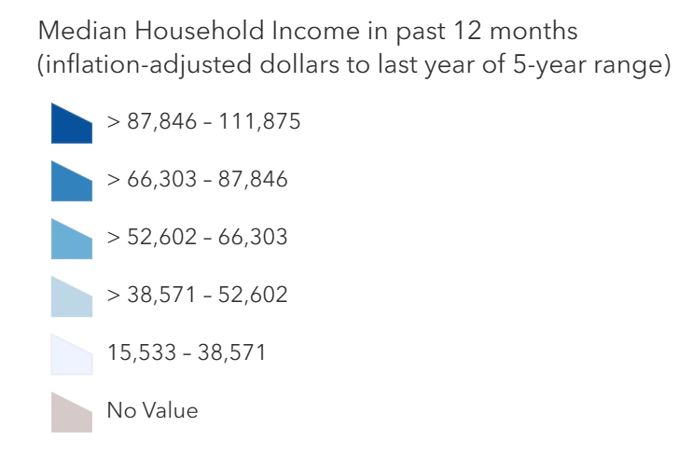
Median Household Income
Source: American Community Survey (ACS) Median Household Income Variables - Boundaries

Slide 12
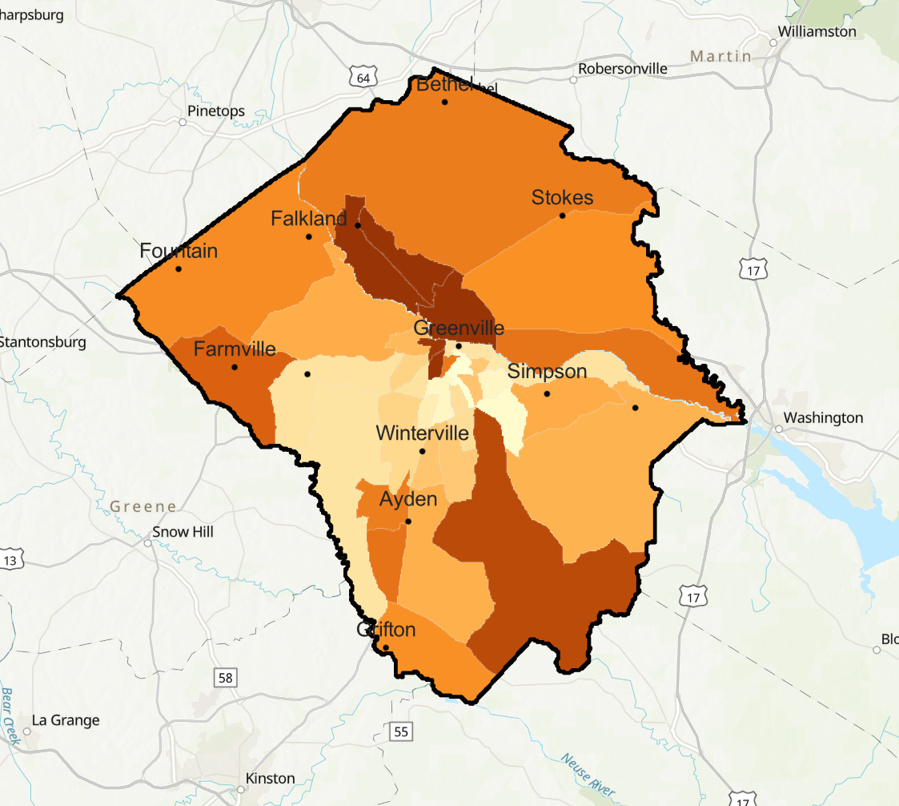
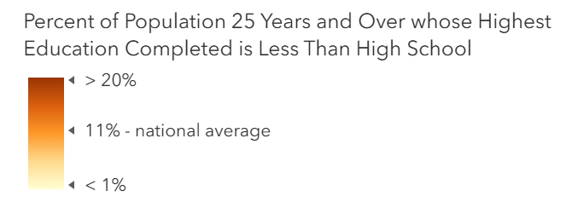
Educational Attainment
Source: American Community Survey (ACS) Educational Attainment Variables - Boundaries

Slide 13
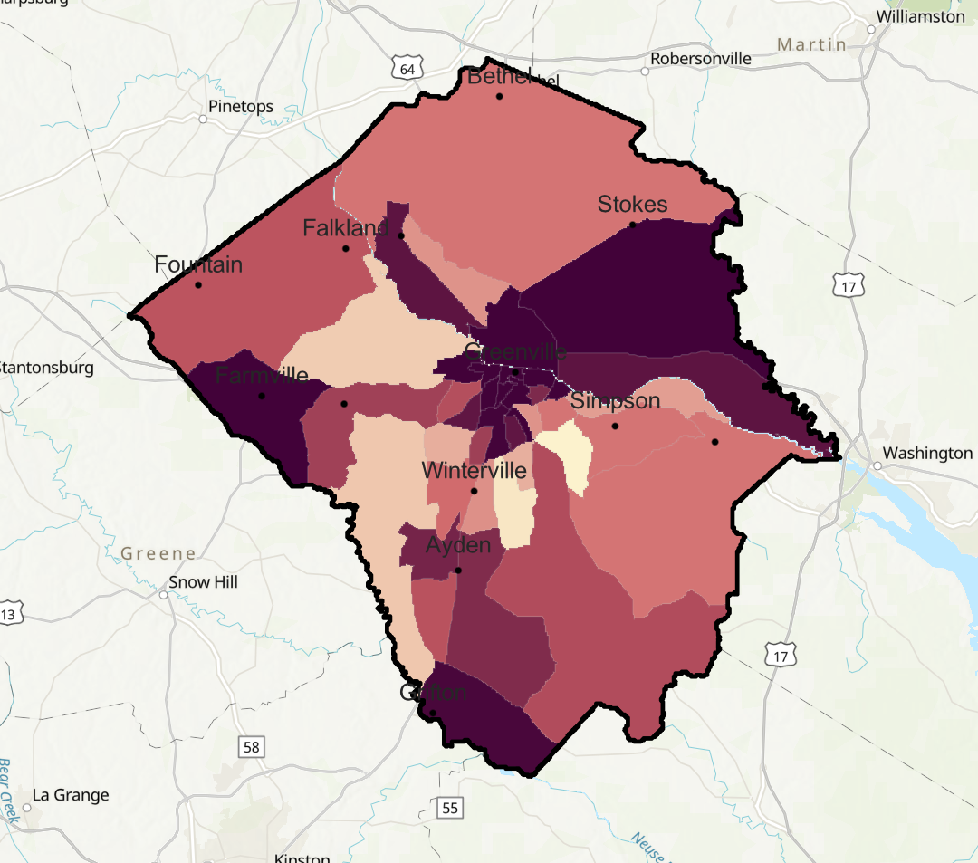
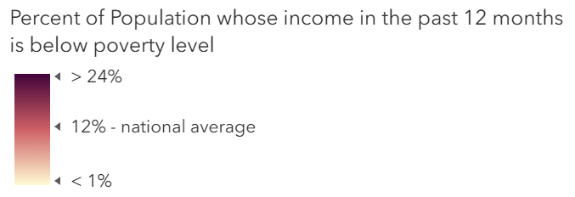
Income Below the Poverty Level
Source: American Community Survey (ACS) Poverty Status Variables - Boundaries

Slide 14
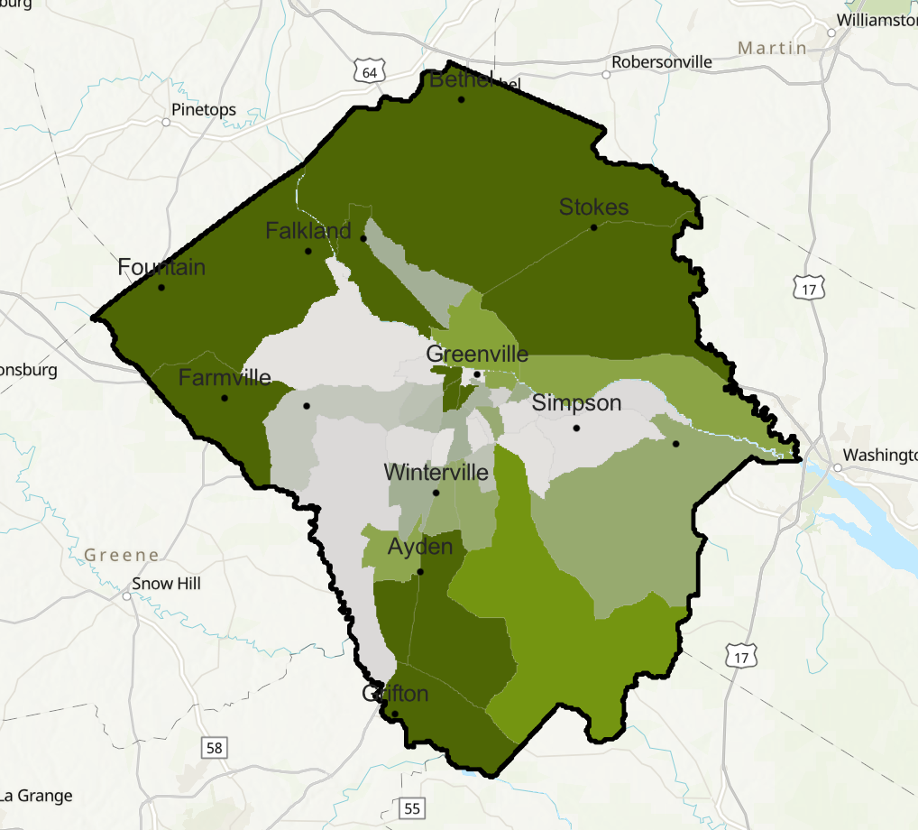
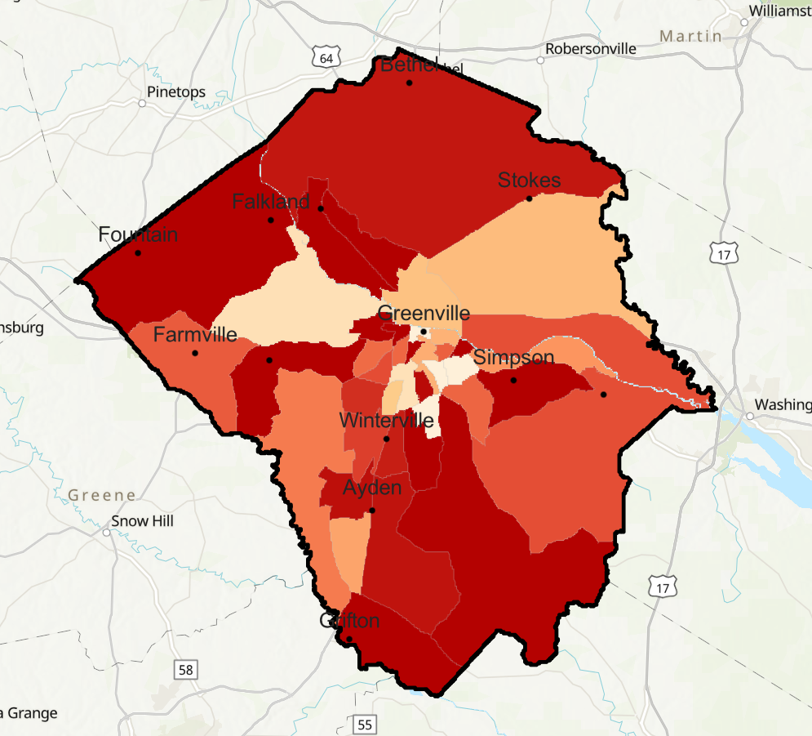
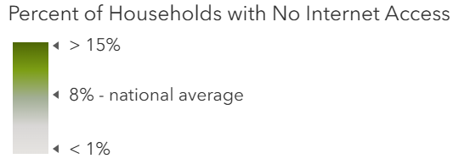
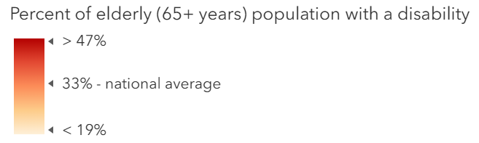
Percent without Internet Disability Status over 65
Source: American Community Survey (ACS) Poverty Status Variables - Boundaries

Slide 15


County Government

Slide 16
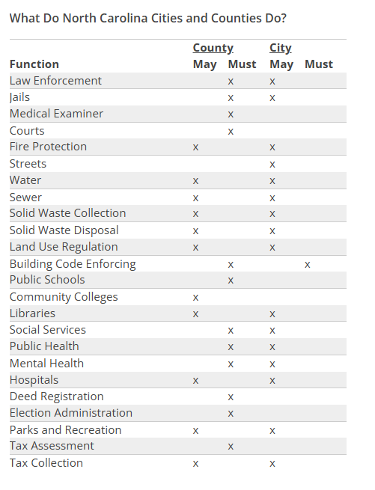

NC Local Government Responsibilities

Slide 17
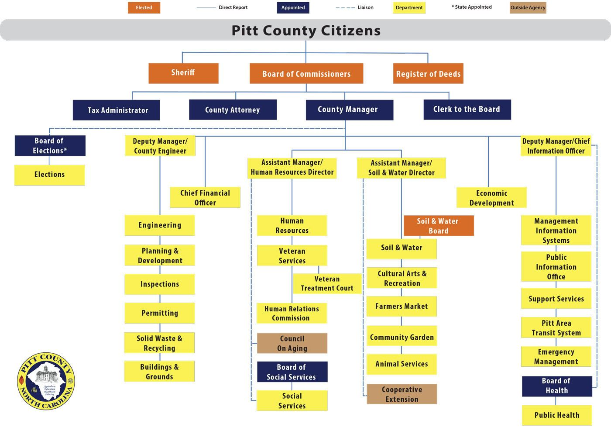
Organizational Structure
Source: Pitt County, North Carolina Official Website

Slide 18
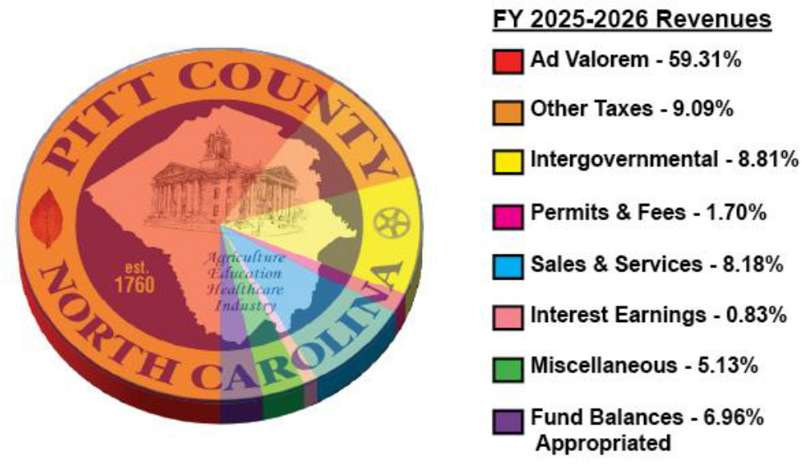
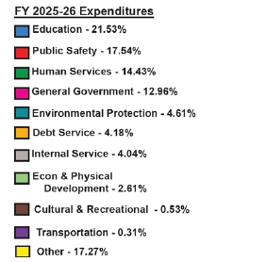
Budget & Revenues
Source: Pitt County, North Carolina Official Website – Annual Budget (June 3, 2025)

Slide 19

Community Input to Date

Slide 20
What are some things that Pitt County does well?

Slide 21
What are some things that Pitt County could do better?

Slide 22
Select the top five things Pitt County should prioritize in its Strategic Plan.

